Slide 1
English/Drama/renaissance MacCormick – Room 3 m.maccormick@bonita.k12.ca.us
Senior central

Slide 2
Welcome to room 3
Room 3 should be seen as a support system for the team of Seniors who are focused on earning a high school diploma. A lot will happen in the next ten months. Throughout it all, do NOT forget that we are here to work together, so we graduate together in June.

Slide 3
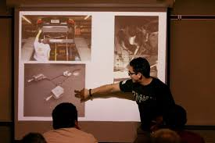
Senior projects
Students will be asked to participate in various self-assessment exercises, create a portfolio, solidify a post-baccalaureate plan and present the results of this experience to a panel.

Slide 4
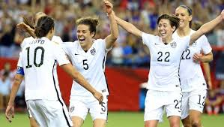
Credits
15 hours worth of work with a grade of 70% or better on all: assignments, quizzes and tests. All assignments must be complete and work shown in order to receive credit. Grades are based on total points accumulated on quizzes, tests, homework, class assignments and class participation.

Slide 5
credits

Slide 6
Classroom Expectations

Slide 7
Circle of trust
Circle Of Trust describes the seating arrangement in this class. There is no seating chart. Seniors are almost adults and they are expected to maintain positive behavior regardless of where they sit. This is also a way to get to know each other.

Slide 8
attendance
ATTENDANCE is crucial. The majority of class time is spent focused on responding to a piece of literature and participating in dialogue pertaining to something we read or write. If you are absent, you miss out on essential discussion time. A student who is not in his/her seat prepared to work when the bell rings is considered tardy.

Slide 9
attendance

Slide 10
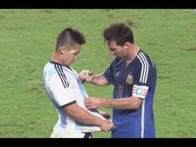
Respect
Respectful Behavior is expected and is to be displayed at all times toward peers, teachers and visitors. Consequences will be applied according to the school district’s discipline policies and procedures for those students who will not be respectful of the behavior expectations.
Please and Thank You
Profanity
Food
Water is welcome.
Restroom

Slide 11
workload
Homework is generally not given unless extra practice is needed. When homework is given, it is to be turned in the following day or no credit will be received.
Tests and Quizzes will be used to assess student understanding of the material. Particularly following the completion of a novel or other reading material, student success may be determined by how much they retain through class discussions.

Slide 12
participation
Participation is a vital part of this class. The only way to learn the subject is to study and practice it. This will be demonstrated by contributing to activities in class (group or paired) and making a
consistent effort to actively learn
throughout the period.
Participation includes preparedness.
Use your voice and perspective.
Say it loud! Say it proud!

Slide 13
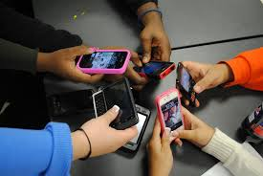
technology
Technology is a big part of how we live and learn. We need to respect when and where we should be utilizing phones, chrome books, etc.

Slide 14
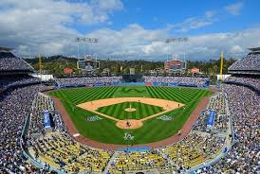
Room 3
Breakfast Club
My Peeps
Dodgers
Fort Edgar
Giving Table

Slide 15
Roberto clemente
“Any time you have an opportunity to make a difference in this world and you don’t, then you are wasting your time on Earth.”

Slide 16
We are in this together!

Slide 17
Get there!

Slide 18
Renaissance
Weekly Rallies
Big Time Rallies
Ozzyball
Dodgeball
Announcements
Quote of the Day
Leadership Presentations
DJ Lunches
Kudos
Brandler App
PSA’s Final Cut Pro Ten

